Slide 1
CSE1004 Network & Communication
Module : IPSec and Secure Sockets Layer (SSL)
Dr. S.L.JAYALAKSHMI
VIT Chennai

Slide 2
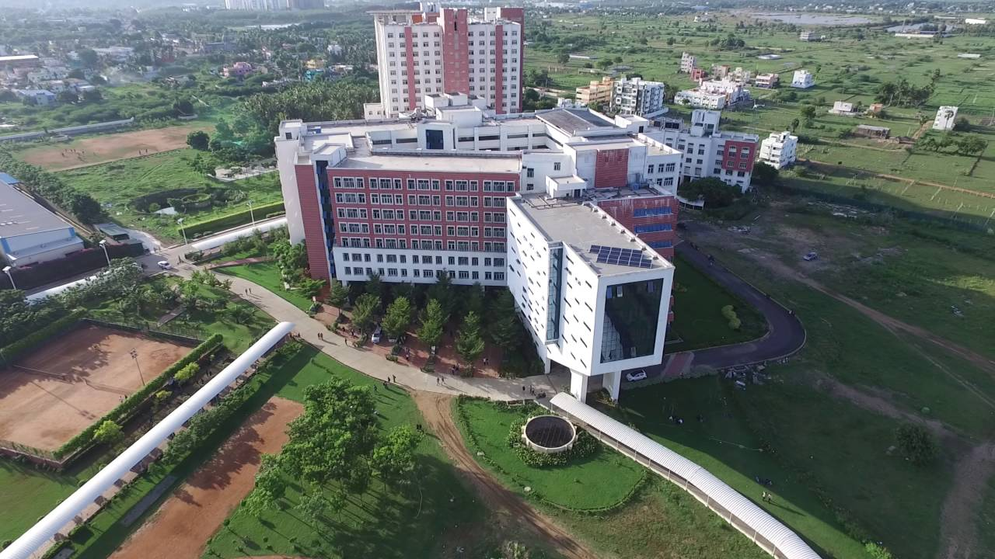
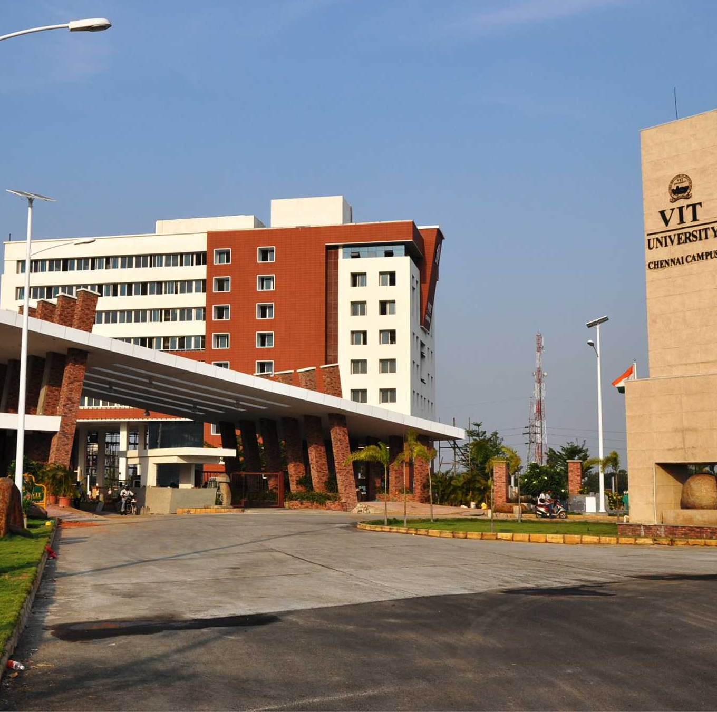
IPSec

Slide 3
Learning Objectives
To introduce IPSec protocol and its two implementation modes: transport and tunnel
To discuss two security protocols : AH and ESP & Services provided by IPSec
To know applications and benefits of IPSec

Slide 4
What is IPSec?
IP Security (IPSec) is a collection of protocols designed by the Internet Engineering Task Force (IETF) to provide security for a packet at the network level
Helps create authenticated and confidential packets for the IP layer
IPSec operates in one of two different modes: transport mode and tunnel mode

Slide 5
IPSec – Key Points
IPSec encompasses 3 function areas: authentication, confidentiality, and key management
Authentication makes use Hash-based message authentication code (HMAC) – applied to the entire original IP packet (tunnel mode) or to all of the packet except for IP header (transport mode)
Confidentiality provided by an encryption format – Encapsulating Security Payload
Internet Key Exchange (IKE) – techniques for key management

Slide 6
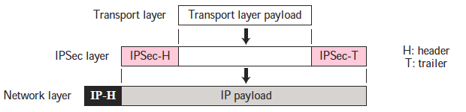
IPSec – Transport mode
IPSec-Transport mode : protects what is delivered from transport layer to network layer – protects the payload to be encapsulated in network layer
IPSec in Transport mode
Does not protect IP header; it only protects the information coming from the transport layer

Slide 7
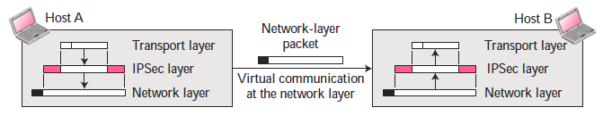
…IPSec – Transport mode
Used when host-to-host (end-to-end) protection of data is needed
Host A uses IPSec to authenticate and/or encrypt the payload from delivered from transport layer
Host B uses IPSec to check the authentication and/or decrypt the IP Packet and deliver to the transport layer

Slide 8
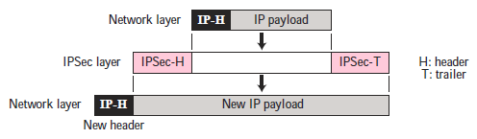

IPSec – Tunnel mode
IPSec-Tunnel mode : protects entire IP packet
Takes an IP packet, including IP header, applies IPSec security methods to the entire IP packet – then adds new IP header
IPSec in Tunnel mode
IPSec in tunnel mode protects the original IP header

Slide 9
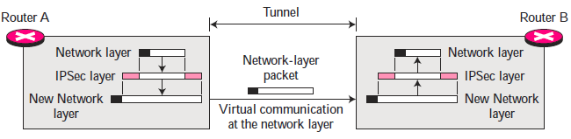
…IPSec – Tunnel mode
New IP header has different information than the original IP header
Used between two routers, between a host and a router, or between a router and a host
The entire original packet is protected from intrusion between the sender and the receiver
Tunnel mode in action

Slide 10
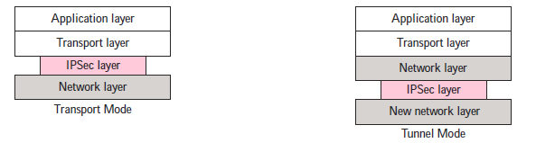
Comparison
Transport mode versus Tunnel mode

Slide 11
Two Security Protocols
Authentication Header (AH) Protocol: To provide authentication for packets at IP level
Encapsulating Security Payload Protocol: To provide encryption for packets at IP level
Authentication Header (AH) Protocol
Designed to authenticate the source host and to ensure the integrity of the payload carried in the IP packet
Uses a hash function and a secret key to create a message digest

Slide 12
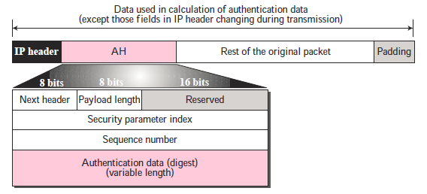
…Two Security Protocols
…Authentication Header (AH) Protocol
The digest is inserted in the AH and then place in the appropriate location based on the mode

Slide 13
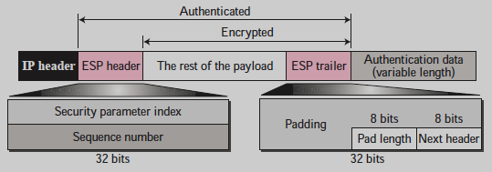
…Two Security Protocols
Encapsulating Security Payload Protocol
Provides source authentication, data integrity and confidentiality
ESP adds a header and trailer
ESP’s authentication data are added at the end of the packet – makes its calculation easier

Slide 14
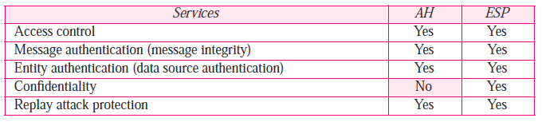
Services Provided by IPSec

Slide 15
Applications of IPSec
Secure branch office connectivity over the network: A company can build a secure virtual private network over the Internet
Secure remote access over the network: An end user can make a local call to an ISP
Establishing extranet and intranet connectivity with partners: can be used to secure communication with other organizations
Enhancing electronic commerce security: adding an additional layer of security to web and electronic commerce applications

Slide 16
Benefits of IPSec
It provides strong security, when IPsec is implemented in a firewall or router
IPsec in a firewall is resistant to bypass all traffic from the outside
No need to change software on a user or server system when IPsec is implemented in the firewall or router
No need to train users on security mechanisms
Can provide security for individual users if needed

Slide 17
SSL

Slide 18
Learning Objectives
SSL Architecture
Services provided by SSL
Four SSL Protocols

Slide 19
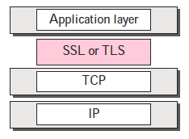
What is Secure Sockets Layer(SSL)?
SSL stands for Secure Sockets Layer, and it refers to a protocol for encrypting and securing communications that take place on the Internet. Although SSL was replaced by an updated protocol called TLS (Transport Layer Security) some time ago, "SSL" is still a commonly used term for this technology.
Designed to provide security and compression service to data generated from application layer protocol (HTTP)
Data received from application is compressed (optional), singed and encrypted then passed to transport layer
Netscape developed – 1994 - Ver. 2 & 3 -1995

Slide 20
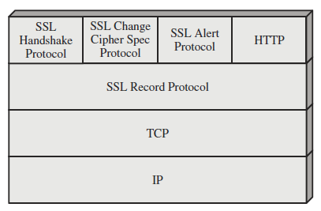
SSL Architecture
Is not a single protocol – two layers of protocol
Record Protocol – provides basic security services to higher layer protocols (HTTP)
Three higher layer protocols – used in management of SSL

Slide 21
…SSL Architecture
Two important SSL concepts : SSL Session & SSL Connection
Connection – is a transport – provides suitable service – peer-to-peer relationships – are transient – associated with one session
Session – an association between a client and a server – created by the Handshake Protocol – define a set of cryptographic parameters shared among multiple connections

Slide 22
Services by SSL
Provides several services on data received from application layer
Fragmentation
Compression
Message Integrity
Confidentiality
Framing

Slide 23
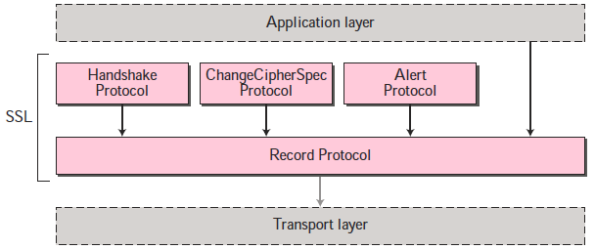
Four Protocols
SSL defines four protocols in two layers

Slide 24
…Four Protocols
Record protocol is the carrier – carries message from three other protocols as well as data coming from application layer – Message from record protocols are payloads to transport layer
Handshake protocol provides key and security parameters – authenticates the server to the client and client to the server if needed
ChangeCipherSpec protocol – used for signaling readiness of cryptographic secrets
Alert protocol – used to report abnormal conditions

Slide 25
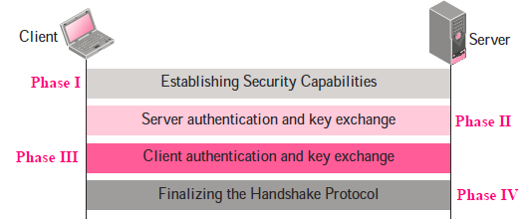
Handshake Protocol
After phase I – the client and serve knows the version of SSL, the cryptographic algorithms, compression method, and two random numbers for key generation

Slide 26
…Handshake Protocol
After phase II – the server is authenticated to the client, and the client knows the public key of the server if required
After phase III – the client is authenticated for the server, both client and server know the pre-master secret
After phase IV – the client and server send message to change cipher specification to finish handshaking protocol

Slide 27
ChangeCipherSpec Protocol
Decides when two parties can use secret parameters by sending a special message during handshaking defined in this protocol
Sender and received need two states
Pending state : keep track of the parameters and secrets
Active state : Hold parameters and secrets used Record protocol to sign/verify and encrypt/decrypt message

Slide 28
Alert Protocol
SSL uses this protocol for reporting errors and abnormal conditions
Uses only one message – describes problem and its level (warning or fatal)

Slide 29
Record Protocol
Processing done by the protocol at the sender
Payload from upper layer protocol
Fragment
Compression
Compressed

Slide 30
...Record Protocol
Other values
Hash
Compressed
MAC Secrets
Compressed
MAC
Encryption
Encrypted Fragment
SSL Payload
RPH

Slide 31
Additional Learning Resources
TCP/IP Protocol Suite, Behrouz A. Forouzan, McGraw Hill, 4th Edition
Cryptography and Network Security, William Stallings, Prentice Hall, 5th Edition
SSL online resource: https://www.geeksforgeeks.org/secure-socket-layer-ssl/
https://www.tutorialsteacher.com/https/how-ssl-works

Slide 32
Additional Learning Resources
TCP/IP Protocol Suite, Behrouz A. Forouzan, McGraw Hill, 4th Edition
Cryptography and Network Security, William Stallings, Prentice Hall, 5th Edition
IPSec Wikipedia: https://en.wikipedia.org/wiki/IPsec

